Slide 1
Data Science & Big Data Analytics Unit-I
Dr. G. Paavai Anand

Slide 2
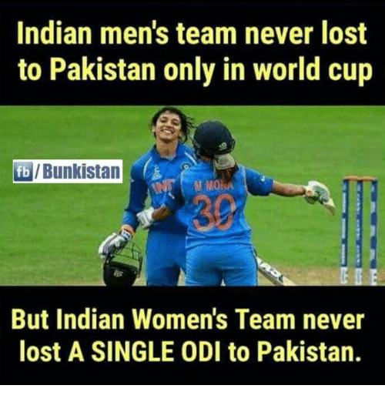
Data Analytics
Data is extracted and categorized to identify and analyze behavioral data and patterns, and techniques vary according to organizational requirements.
Eg. 1 – Prediction in the game of Cricket
Eg. 2 – Prediction of your exam score

Slide 3
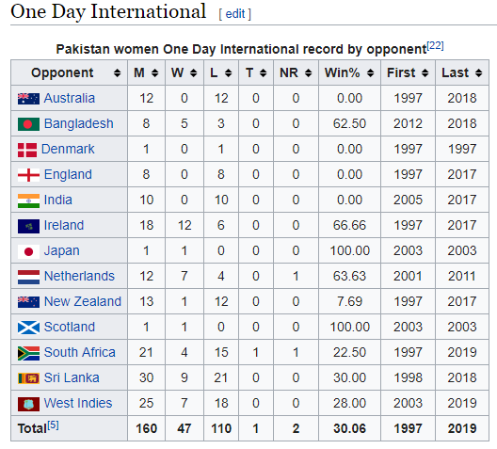

Slide 4
Types of Analytics
Descriptive: A set of techniques for reviewing and examining the data set(s) to understand the data and analyze business performance.
Diagnostic: A set of techniques for determine what has happened and why
Predictive: A set of techniques that analyze current and historical data to determine what is most likely to (not) happen
Prescriptive: A set of techniques for computationally developing and analyzing alternatives that can become courses of action – either tactical or strategic – that may discover the unexpected
Decisive: A set of techniques for visualizing information and recommending courses of action to facilitate human decision-making when presented with a set of alternatives.

Slide 5
Introduction to big data

Slide 6
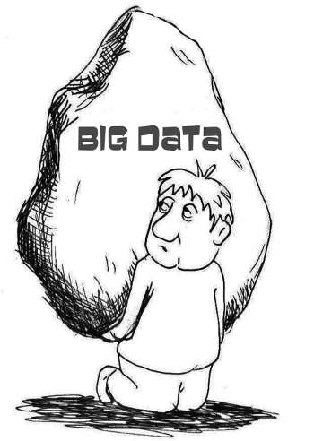
What is Big data?
Big Data is the amount of data just beyond technology’s capability to store, manage and process efficiently.

Slide 7
Big Data is data whole scale, diverse and complex - requires new architecture, techniques, algorithms and analytics to manage it and extract value and hidden knowledge from it…

Slide 8
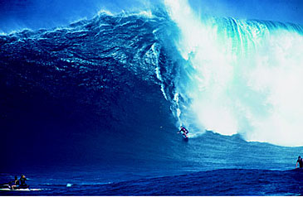
Trends leading to Data Flood
More data is generated:
Bank, telecom, other business transactions ...
Scientific data: astronomy, biology, etc
Web, text, and e-commerce

Slide 9
Big Data Examples
Europe's Very Long Baseline Interferometry (VLBI) has 16 telescopes, each of which produces 1 Gigabit/second of astronomical data over a 25-day observation session
storage and analysis a big problem
AT&T handles billions of calls per day
so much data, it cannot be all stored -- analysis has to be done “on the fly”, on streaming data

Slide 10
Largest databases in 2003
Commercial databases:
Winter Corp. 2003 Survey: France Telecom has largest decision-support DB, ~30TB; AT&T ~ 26 TB
Web
Alexa internet archive: 7 years of data, 500 TB
Google searches 4+ Billion pages, many hundreds TB
IBM WebFountain, 160 TB (2003)
Internet Archive (www.archive.org),~ 300 TB

Slide 11
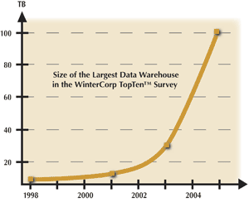
Data Growth
In 2 years, the size of the largest database TRIPLED!

Slide 12
Data Growth Rate
Twice as much information was created in 2002 as in 1999 (~30% growth rate)
Other growth rate estimates even higher
Very little data will ever be looked at by a human
Knowledge Discovery is NEEDED to make sense and use of data.

Slide 13
Big data characteristics

Slide 14
Big Data
Big Data is any data that is expensive to manage and hard to extract value from
Volume
The size of the data
Velocity
The latency of data processing relative to the growing demand for interactivity
Variety and Complexity
the diversity of sources, formats, quality, structures.

Slide 15
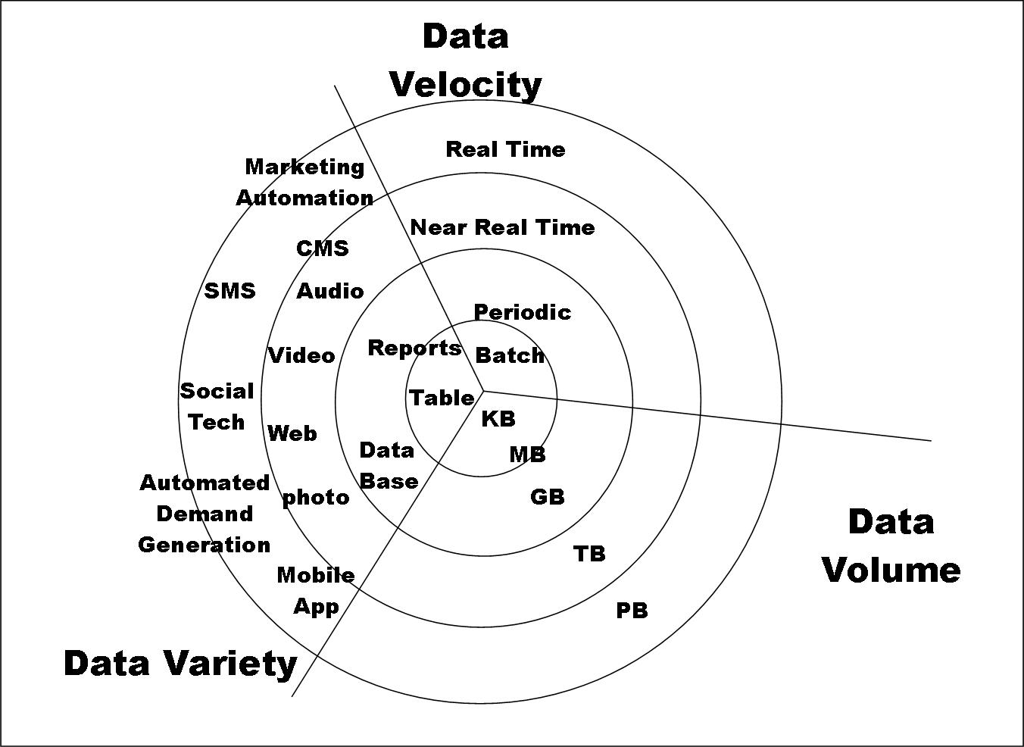
Big Data

Slide 16
Characteristics - Some Big Data Issues Affecting Analytics
Volume:
How much data is really relevant to the problem solution? Cost of processing?
So, can you really afford to store and process all that data?
Velocity:
Much data coming in at high speed
Need for streaming versus block approach to data analysis
So, how to analyze data in-flight and combine with data at-rest
Variety:
A small fraction is structured formats, Relational, XML, etc.
A fair amount is semi-structured, as web logs, etc.
The rest of the data is unstructured text, photographs, etc.
So, no single data model can currently handle the diversity
Veracity:
Accuracy, Precision, Reliability, Integrity (Trustworthiness of data)
So, what is it that you don’t know you don’t know about the data?
Value:
How much value is created for each unit of data (whatever it is)?
So, what is the contribution of subsets of the data to the problem solution?

Slide 17
R – Introduction

Slide 18
# import a csv file of the total annual sales for each customer
sales <- read.csv("C:/Users/A/Desktop/yearly_sales.csv")
# examine the imported dataset
head(sales)
cust_id sales_total num_of_orders gender
100001 800.64 3 F
100002 217.53 3 F
100003 74.58 2 M
100004 498.60 3 M
100005 723.11 4 F
100006 69.43 2 F

Slide 19
summary(sales)
cust_id sales_total num_of_orders gender
Min. :100001 Min. : 30.02 Min. : 1.000 F:5035
1stQu.:102501 1st Qu.: 80.29 1st Qu.: 2.000 M:4965
Median :105001 Median : 151.65 Median : 2.000
Mean :105001 Mean : 249.46 Mean : 2.428
3rdQu.:107500 3rd Qu.: 295.50 3rd Qu.: 3.000
Max. :110000 Max. :7606.09 Max. :22.000

Slide 20
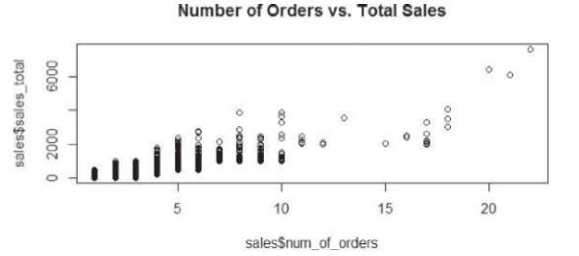
plot(sales$num_of_orders,sales$sales_total,
main="Number of Orders vs. Sales")

Slide 21
results <- lm(sales$sales_total ~ sales$num_of_orders)
results
Call: lm(formula = sales$sales_total ˜ sales$num_of_orders)
Coefficients:
(Intercept) sales$num_of_orders -154.1 166.2

Slide 22
summary(results)
Call: lm(formula = sales$sales_total ˜ sales$num_of_orders)
Residuals:
Min 1Q Median 3Q Max
-666.5 -125.5 -26.7 86.6 4103.4
Coefficients:
Estimate Std. Error t value Pr(>|t|)
(Intercept) -154.128 4.129 -37.33 <2e-16
***
sales$num_of_orders 166.221 1.462 113.66 <2e-16 *** –
Signif. codes: 0 ‘***’ 0.001 ‘**’ 0.01 ‘*’ 0.05 ‘.’ 0.1 ‘ ‘ 1
Residual standard error: 210.8 on 9998 degrees of freedom Multiple R-squared: 0.5637,
Adjusted R-squared: 0.5637
F-statistic: 1.292e+04 on 1 and 9998 DF,
p-value: < 2.2e-16

Slide 23
Generic function
The summary() function is an example of a generic function.
A generic function is a group of functions sharing the same name but behaving differently depending on the number and the type of arguments they receive.
Plot() and hist() are other generic functions

Slide 24
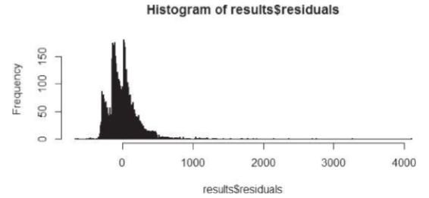
hist(results$residuals, breaks = 800)

Slide 25
R graphical user interfaces

Slide 26
R software uses a command-line interface (CLI) that is similar to the BASH shell in Linux or the interactive versions of scripting languages such as Python.
UNIX and Linux users can enter command R at the terminal prompt to use the CLI.
For Windows installations, R comes with RGui.exe, which provides a basic graphical user interface (GUI).
However, to improve the ease of writing, executing, and debugging R code, several additional GUIs have been written for R.
Popular GUIs include the R commander [3], Rattle [4], and RStudio [5].

Slide 27
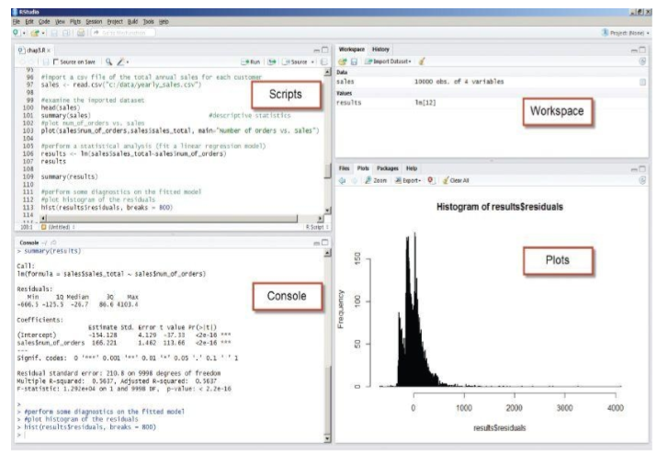

Slide 28
The four highlighted window panes follow.
Scripts: Serves as an area to write and save R code
Workspace: Lists the datasets and variables in the R environment
Plots: Displays the plots generated by the R code and provides a straightforward mechanism to export the plots
Console: Provides a history of the executed R code and the output
edit() and fix() functions to allow the user to update the contents of an R variable.
In Rstudio, we can select the variables from the workspace pane and do the same.
R saves the workspace environment into .Rdata file using the save.image() function.
Load.image() function allows us to load the previously saved workspace.

Slide 29
Data Import and Export

Slide 30
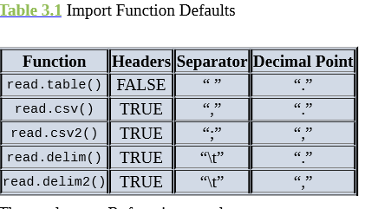
sales <- read.csv(“c:/data/yearly_sales.csv”)
setwd(“c:/data/”)
sales <- read.csv(“yearly_sales.csv”)
sales_table<-read.table(“yearly_sales.csv”, header=TRUE, sep=”,”)
Sale
s_delim <- read.delim(“yearly_sales.csv”, sep=”,”)

Slide 31
The analogous R functions such as write.table(), write.csv(), and write.csv2()
# add a column for the average sales per order
sales$per_order<-sales$sales_total/sales$num_of_orders
# export data as tab delimited without the row names
write.table(sales,“C:/Users/A/Desktop/sales_modified.txt”, sep=”\t”, row.names=FALSE

Slide 32
Database connectivity – need to install ROBDC package before executing these commands
install.packages(“RODBC”)
library(RODBC)
conn <- odbcConnect(“training2”, uid=“user”, pwd=“password”)
housing_data <- sqlQuery(conn, “select serialno, state, persons, rooms from housing where hinc > 1000000”)
head(housing_data)

Slide 33
Convert the histogram to JPEG file
jpeg(file=“c:/data/sales_hist.jpeg”)
# create a new jpeg file hist(sales$num_of_orders)
# export histogram to jpeg
dev.off()
# shut off the graphic device

Slide 34
Attribute and Data Types

Slide 35
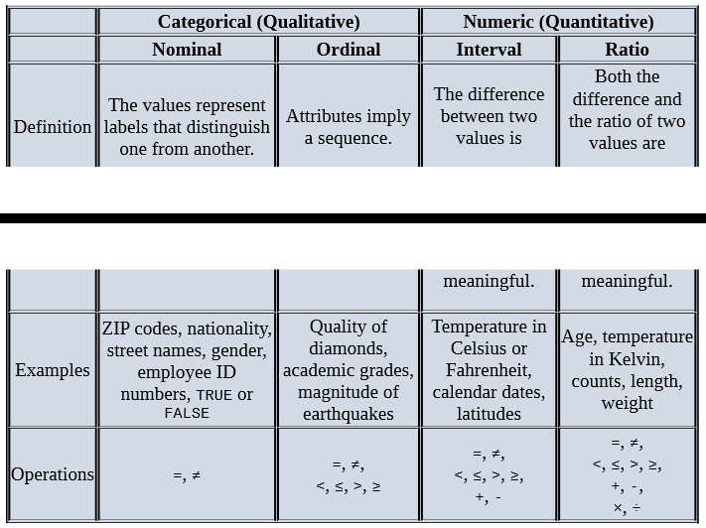

Slide 36
Numeric, Character, and Logical Data Types
i <- 1
# create a numeric variable
sport <- “football”
# create a character variable
flag <- TRUE
# create a logical variable
class(i) # returns “numeric”
typeof(i) # returns “double”
class(sport) # returns “character”
typeof(sport) # returns “character”
class(flag) # returns “logical”
typeof(flag) # returns “logical”
is.integer(i) # returns FALSE
j<-as.integer(i) # coerces contents of I into an integer
is.integer(j) # returns TRUE
length(i) # returns 1
length(flag) # returns 1
length(sport) # returns 1(not 8 for “football”)
-----because these are single entities called vectors

Slide 37
Vectors
is.vector(i) # returns TRUE
is.vector(flag) # returns TRUE
is.vector(sport) # returns TRUE
u <- c(“red”, “yellow”, “blue”)
# create a vector “red” “yellow” “blue”
u
# returns “red” “yellow” “blue”
u[1]
# returns “red” (1st element in u)
v <- 1:5
# create a vector 1 2 3 4 5
v
# returns 1 2 3 4 5
sum(v)
# returns 15
w<-v*2
# create a vector 2 4 6 8 10
w
# returns 2 4 6 8 10

Slide 38
w[3]
#returns 6 (the 3rd element of w)
z<-v+w
#sums two vectors element by element
z
#returns 3 6 9 12 15
z>8
#returns FALSE FALSE TRUE TRUE TRUE
z[z>8]
#returns 9 12 15
z[z>8 | z < 5]
#returns 3 9 12 15 (“|” denotes “or”)

Slide 39
a<-vector(length=3)
#create a logical vector of length 3
a
#returns FALSE FALSE FALSE
b<-vector(mode=“numeric”, 3)
#create a numeric vector of length 3
typeof(b)
#returns “double”
b[2]<-3.1
#assign 3.1 to the 2nd element
b
#returns 0.0 3.1 0.0
c<-vector(mode=“integer”, 0)
#create an integer vector of length 0
c
#returns integer(0)
length(c)
#returns 0
length(b) # returns 3
dim(b) # returns NULL (an undefined value)

Slide 40
Arrays and Matrices
# the dimensions are 3 regions, 4 quarters, and 2 years
quarterly_sales<-array(0, dim=c(3,4,2))
quarterly_sales[2,1,1]<-158000
quarterly_sales
, ,
[,1] [,2] [,3] [,4]
[1,] 0 0 0 0
[2,] 158000 0 0 0
[3,] 0 0 0 0
, , 2
[,1] [,2] [,3] [,4]
[1,] 0 0 0 0
[2,] 0 0 0 0
[3,] 0 0 0 0
# A two-dimensional array is known as a matrix.

Slide 41
sales_matrix<-matrix(0,nrow=3, ncol= 4)
sales_matrix
[,1] [,2] [,3] [,4]
[1,] 0 0 0 0
[2,] 0 0 0 0
[3,] 0 0 0 0

Slide 42
Data Frames
#import a CSV file of the total annual sales for each customer
sales<-read.csv(“c:/data/yearly_sales.csv”)
is.data.frame(sales) # returns TRUE
length(sales$num_of_orders) #returns 10000 (number of customers)
is.vector(sales$cust_id) # returns TRUE is.vector(sales$sales_total) # returns TRUE is.vector(sales$num_of_orders) # returns TRUE is.vector(sales$gender) # returns FALSE is.factor(sales$gender) # returns TRUE

Slide 43
str(sales)
# display structure of the data frame object
‘data.frame’: 10000 obs. of 4 variables:
$cust_id : int 100001 100002 100003 100004 100005 100006 …
$sales_total : num 800.6 217.5 74.6 498.6 723.1 …
$num_of_orders : int 3 3 2 3 4 2 2 2 2 2 …
$gender : Factor w/ 2 levels “F”,“M”: 1 1 2 2 1 1 2 2 1 2 …

Slide 44
#extract the fourth column of the sales data frame
sales[,4]
#extract the gender column of the sales data frame
sales$gender
#retrieve the first two rows of the data frame
sales[1:2,]
#retrieve the first, third, and fourth columns sales[,c(1,3,4)]
#retrieve both the cust_id and the sales_total columns
sales[,c(“cust_id”, “sales_total”)]
#retrieve all the records whose gender is female
sales[sales$gender==“F”,]
class(sales)
“data.frame”
typeof(sales)
“list”

Slide 45
Lists
# build an assorted list of a string, a numeric, a list, a vector,
# and a matrix
housing<-list(“own”, “rent”)
assortment <-list(“football”, 7.5, housing, v, M)
assortment
[[1]]
[1] “football”
[[2]]
[1] 7.5
[[3]]
[[3]][[1]]
[1] “own”
[[3]][[2]]
[1] “rent”
[[4]]
[1] 1 2 3 4 5
[[5]] [,1] [,2] [,3]
[1,] 1 5 3
[2,] 3 0 3 [3,] 3 4 3

Slide 46
# examine the fifth object, M, in the list
class(assortment[5]) # returns “list”
length(assortment[5])
class(assortment[[5]]) # returns “matrix”
length(assortment[[5]])# returns 9 (for the 3x3 matrix)

